Slide 1
Augmented and Virtual Reality introduction

Slide 2
Part 1- Augmented Reality (AR)

Slide 3
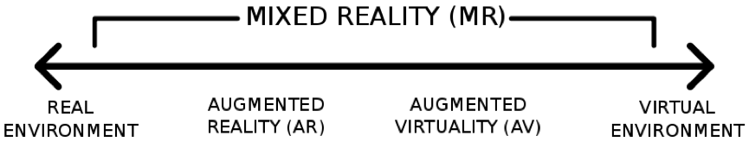
Mixed Reality
Mixed Reality (sometimes called Hybrid Reality or MR) aims to combine the best aspects of both virtual reality تخيليand augmented reality
أشكال مضافة على الواقع.
It also refers to the entire spectrum of situations that span the continuum between virtual reality and actual reality.

Slide 4
Augmented Reality
Augmented Reality (AR) is a technology or an environment where the additional information generated by a computer is inserted into the user’s view of real world scene.
The augmenting information may consist of virtual geometric objects placed into the environment, or a display of non-geometric information about existing real objects such as distribution of room temperature.

Slide 5
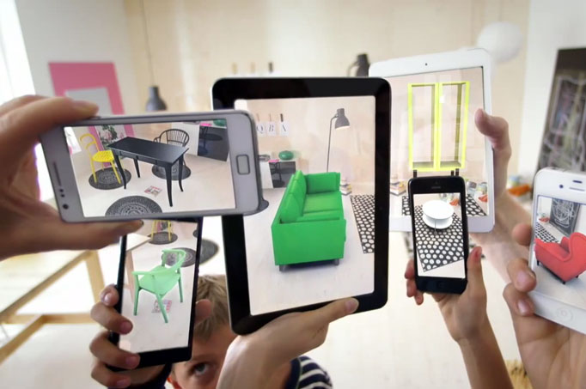
Introduction
Augmented Reality (AR) refers to a live, direct or indirect, view of a physical, real-world environment whose elements are augmented by computer-generated sensory input such as sound, video, graphics or GPS data.
AR is used to enhance natural environments or situations and offer perceptually enriched experiences.
Source: Wikipedia

Slide 6
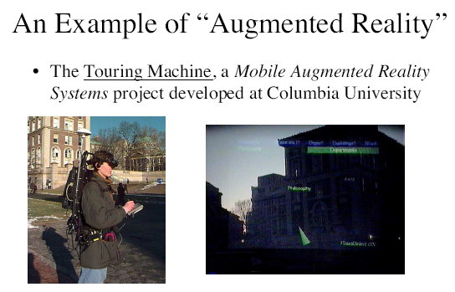
Augmented Reality

Slide 7
Virtual (VR) vs Augmented (AR) Reality
VR - “Replaces reality”
Generation of virtual scene requires realistic images
Displaying devices should be total immersive, with high FOV
Tracking accuracy can be low to medium
AR - “Enhances reality”
Scene generation can be made with a smaller rendering quality
Displays are non-immersive, small FOV
Tracking accuracy should be high
Source: http://www.techquarters.com/virtual-reality-vs-augmented-reality/

Slide 8

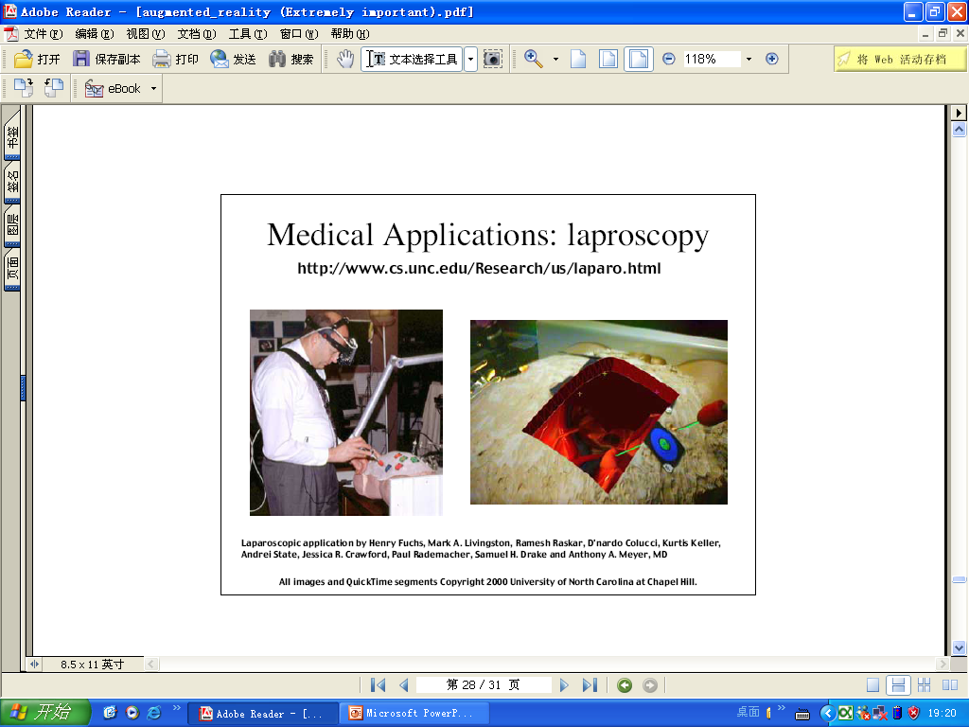
AR Applications
Applications of Augmented Reality
Medical: Display of acquired data from ultrasound, superimposed over the live patient
Goal - to facilitate minimally invasive operations such as fine needle biopsies, and laproscopic surgeries

Slide 9
Augmented Reality types
The Augmented Reality technology can work using one of the following approaches:
SLAM
Recognition based
Location Based
Projection Based Augmented Reality

Slide 10
1-SLAM
SLAM (Simultaneous Localization and Mapping) is the most effective way to render virtual images over real-world objects.
SLAM simultaneously localizes sensors with respect to their surroundings, while at the same time mapping the structure of the environment.
The SLAM system is a set of algorithms aimed at solving simultaneous localization and mapping problem.
Example :
https://youtu.be/ufvPS5wJAx0

Slide 11
SLAM (2)
The SLAM algorithm has two aims:
Build a map of the environment
Locate the device within that environment
Before SLAM :
If you have the freedom of placing beacons at known locations, you simply need to triangulate the distances and you know exactly where you are.
For other applications, GPS might be good enough.
However, mobile Augmented Reality usually doesn’t have the luxury of known beacons. Neither is GPS accurate enough – especially indoors.
More details : https://www.andreasjakl.com/basics-of-ar-slam-simultaneous-localization-and-mapping/

Slide 12
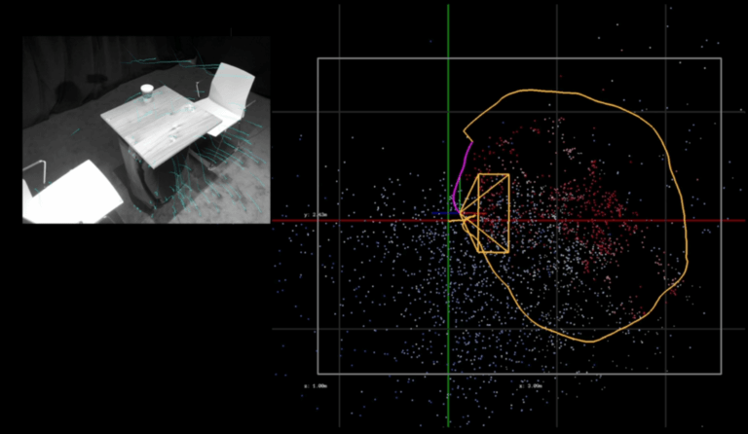
SLAM(3)
https://www.andreasjakl.com/basics-of-ar-slam-simultaneous-localization-and-mapping/

Slide 13
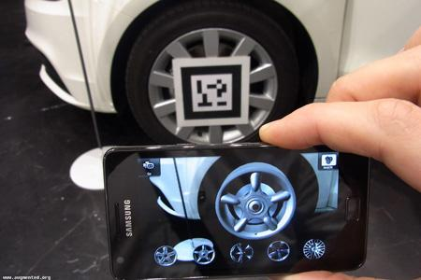
2. Recognition based (marker-based)
Recognition (or marker) based augmented reality uses a camera to identify visual markers or objects, such as:
QR code
Bar code
or natural feature tracking (NFT) markers صور طبيعية يمكن استخلاص خصائص مميزة لها,
it shows an overlay
طبقة اضافية على الصورة only when the marker is sensed by the device.
Marker-based AR technology depends upon device camera to distinguish a marker from other real-world objects.
Not only the marker image but the position and orientation can also be calculated.
Once recognized the marker on screen is replaced with a virtual 3D version of the corresponding object. This is done to permit the user to observe the object in more detail and from various angles. Rotating the marker would rotate the virtual replication as well.

Slide 14
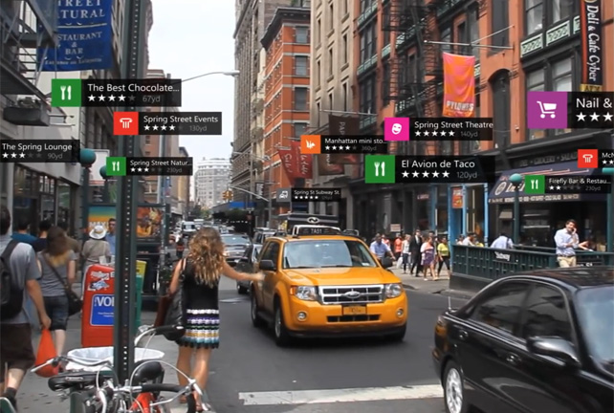
3. Location Based (Markerless)
Contrary to recognition based, location-based AR relies on a GPS, digital compass, velocity meter, or accelerometer to provide data about the location and the augmented reality visualizations are activated based on these inputs.
It is also known as markerless augmented reality.
The location detection features in smartphones make it easy to leverage this type of augmented reality technology, making it quite popular.
Some common uses of location-based AR include mapping directions, finding nearby services, and other location-centric mobile apps.

Slide 15
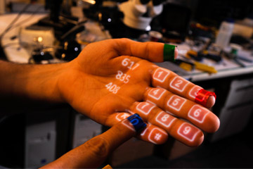
4- Projection Based Augmented Reality
Projection based augmented reality works by projecting artificial light onto real world surfaces. Projection based augmented reality applications allow for human interaction by sending light onto a real world surface and then sensing the human interaction (i.e. touch) of that projected light. Detecting the user’s interaction is done by differentiating between an expected (or known) projection and the altered projection (caused by the user's interaction). Another interesting application of projection based augmented reality utilizes laser plasma technology to project a three-dimensional (3D) interactive hologram into mid-air.

Slide 16
Different AR Devices
Mobile Phones:
In case of mobile devices like smartphones and tablets, augmented reality technology can be used either through location services or camera or a combination of both. The viewer can see the input from the camera being modified on the screen. There are many location-based apps available for Android and iOS platform.
PC and Smart TVs:
PC and connected TV players support Augmented Reality by relaying the virtual objects over the input from a webcam. Since it a hectic process to manipulate a tracker in front of your screen there aren’t many applications of AR on PCs or smart TVs.
Smart Glasses:
Head-mounted displays, glasses, and lenses (yeah, we have it coming!) also support the Augmented Reality technology by making it an integral part of your entire field of view. This gives a more life-like AR experience giving a much broader scope of applications. For instance, there is an AR helmet that can give you life-like augmented reality experience while driving. This means you can get information about directions, speed, etc. without the need to look at the speedometer or mobile phone.

Slide 17
Key Components to Augmented Reality Devices
1- Sensors and Cameras
Sensors are usually on the outside of the augmented reality device, and gather a user's real world interactions and communicate them to be processed and interpreted. Cameras are also located on the outside of the device, and visually scan to collect data about the surrounding area. The devices take this information, which often determines where surrounding physical objects are located, and then formulates a digital model to determine appropriate output.

Slide 18
Key Components to Augmented Reality Devices (2)
2-Projection
While “Projection Based Augmented Reality” is a category in-itself, we are specifically referring to a miniature projector often found in a forward and outward-facing position on wearable augmented reality headsets. The projector can essentially turn any surface into an interactive environment.

Slide 19
Key Components to Augmented Reality Devices (3)
3-Processing
Augmented reality devices are basically mini-supercomputers packed into tiny wearable devices. These devices require significant computer processing power and utilize many of the same components that our smartphones do. These components include a CPU, a GPU, flash memory, RAM, Bluetooth/Wifi microchip, global positioning system (GPS) microchip, and more. Advanced augmented reality devices, such as the Microsoft Hololens utilize an accelerometer (to measure the speed in which your head is moving), a gyroscope (to measure the tilt and orientation of your head), and a magnetometer (to function as a compass and figure out which direction your head is pointing) to provide for truly immersive experience.

Slide 20
AR for work training
https://www.youtube.com/watch?v=RpXyagutoZg
https://www.youtube.com/watch?v=nFSAxMKHNMY
https://www.youtube.com/watch?v=KS_5OHoHHuo
https://www.youtube.com/watch?v=Zx3vwI59Oe4
AR for fun
https://www.youtube.com/watch?v=fv71Pe9kTU0
AR for campaigns/advertisement
https://www.youtube.com/watch?v=h2Jg8ryVk1k

Slide 21
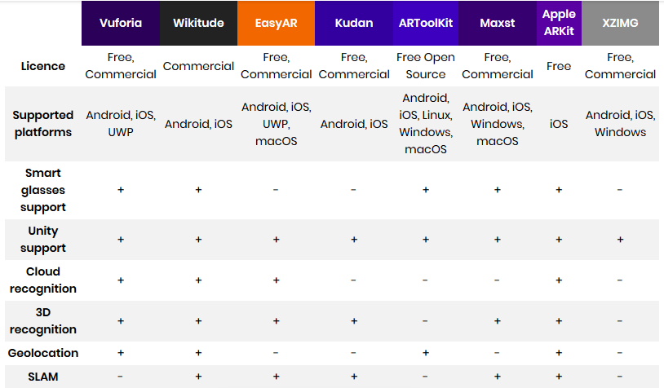
Known AR SDKs for programmers للاطلاع https://rubygarage.org/blog/best-tools-for-building-augmented-reality-mobile-apps

Slide 22
What Web AR means (Augmented Reality on the Web)
Augmented Reality is the technology that makes possible to add overlayed content on the real world. It can be provided for several type of devices: handleheld (like mobile phones), headsets, desktop displays, and so on.
For handleheld devices (more in general, for video-see-through devices) the 'reality' is captured from one or more cameras and then shown on the device display, adding some kind of content on top of it.
AR.js is one of the javascript libraries for web AR
https://ar-js-org.github.io/AR.js-Docs /

Slide 23
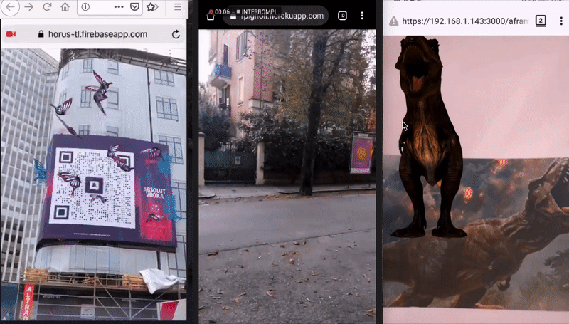
What Web AR means (Augmented Reality on the Web)
https://ar-js-org.github.io/AR.js-Docs /

Slide 24
Part 2- Virtual Reality (VR)

Slide 25
Introduction
Virtual
something not physically existent
Reality
something physically existent
Virtual Reality
something not real but felt as real

Slide 26
What’s VR?
VR is a computer interfaces which tries to mimic (simulate) real world beyond the flat monitor to give an immersive 3D (Three Dimension) visual experiences
تجربة يندمج معها المستخدم.

Slide 27
Application Areas for VR
Education
Healthcare
Entertainment
Business
Engineering
Sport
Media
Virtual Reality and Scientific Visualization
Telecommunications
Construction
And more…

Slide 28
Video Clips of Virtual Reality (VR) Examples
VR for Medical Purposes:
https://www.youtube.com/watch?v=AttXbcLUyR0
VR for education:
-(Playlist)
https://www.youtube.com/watch?v=etn2zCa7n40&list=PLsEIM9hdIUosSlpteW-aUbT19LopPbwmM
- https://www.youtube.com/watch?v=iofuy7tTiYE
VR Training
https://www.youtube.com/watch?v=0NormS9SIow
https://www.youtube.com/watch?v=-hPFqRzBh4o
VR for Exploring and Travel
https://www.youtube.com/watch?v=a3kwztYUueQ
https://www.youtube.com/watch?v=Ax0BmO3DrTc
VR for Entertainment
https://www.youtube.com/watch?v=-jgMadAaPpA
https://www.youtube.com/watch?v=fvu5FxKuqdQ

Slide 29
Virtual Reality
https://en.wikipedia.org/wiki/Virtual_reality
Virtual World
https://en.wikipedia.org/wiki/Virtual_world
Virtual Reality Headset
https://en.wikipedia.org/wiki/Virtual_reality_headset
What is VR
www.digitaltrends.com/computing/what-is-vr-all-the-basics-of-virtual-reality
Realism in VR
https://www.youtube.com/watch?v=akveRNY6Ulw&t=131s
The History of Virtual Reality
https://www.youtube.com/watch?v=4BOwLCoBqCs
Virtual Reality Cave
https://www.youtube.com/watch?v=UT5xtpHRdlE&t=27s

Slide 30
VR Fundamentals
https://www.youtube.com/watch?v=mpv6dqCzG0o
Virtual Reality Field of View Demo
https://www.youtube.com/watch?v=Iwt6YOdA7Jk
VR Headset with 200 Field of View
https://www.youtube.com/watch?v=J3LStflzGFI
Immersion Cave System Laval Virtual https://www.youtube.com/watch?v=phbV_nYYiYk

Slide 31
AR medical school training https://www.youtube.com/watch?v=dWf7oEwZKbs&t=6s
AR in architecture https://www.youtube.com/watch?v=zVN_Pc-Ytuw
AR in sports https://www.youtube.com/watch?v=UgfY1OUkFgo
AR in marketing https://www.youtube.com/watch?v=HqMVZm0klW
VR in engineering training https://www.youtube.com/watch?v=IcmX_XtmZHg

Slide 32
Key Elements of a Virtual Reality Experience
1- Virtual World
A virtual world is a three-dimensional environment that is often, but not necessarily, realized through a medium (i.e. rendering, display, etc.) where one can interact with others and create objects as part of that interaction. In a virtual world, visual perspectives are responsive to changes in movement and interactions mimic those experienced in the real world.
2- Immersion
الاندماج
Virtual reality immersion is the perception of being physically present in a non-physical world.
Two common types of immersion include:
Mental Immersion – اندماج ذهني A deep mental state of engagement, with suspension of disbelief that one is in a virtual environment.
Physical Immersion – اندماج فعلي Exhibited physical engagement in a virtual environment, with suspension of disbelief that one is in a virtual environment.

Slide 33
Key Elements of a Virtual Reality Experience (2)
3- Sensory Feedback
التعامل مع حواس الانسان
Virtual reality requires as many of our senses as possible to be simulated. These senses include vision (visual), hearing (aural), touch (haptic), and more.
4- Interactivity
التفاعل
The element of interaction is crucial for virtual reality experiences to provide users with enough comfort to naturally engage with the virtual environment.

Slide 34
Types of Virtual Reality [Virtual Reality (VR) Categories]
Several categories of virtual reality technologies exist, with more likely to emerge as this technology progresses. The various types of virtual reality differ in their levels of immersion
Below, we explore a few of the different categories of virtual reality:
Non-immersive simulations
Semi-immersive simulations
Fully-immersive simulations

Slide 35
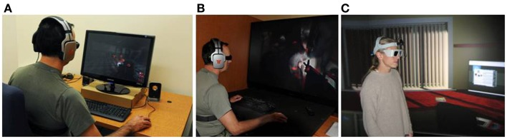
1. Non-immersive simulations
Non-immersive simulations
The least immersive implementation of virtual reality technology.
In a non-immersive simulation, only a subset of the user's senses are stimulated, allowing for peripheral awareness of the reality outside the virtual reality simulation.
Users enter into these three-dimensional virtual environments through a portal or window by utilising standard high resolution monitors powered by processing power typically found on conventional desktop workstations.

Slide 36

2. Semi-immersive simulations
Semi-immersive simulations provide a more immersive experience, in which the user is partly but not fully immersed in a virtual environment.
Semi-immersive simulations are powered by high performance graphical computing systems, which are often then coupled with large screen projector systems or multiple television projection systems to properly stimulate the user's visuals.

Slide 37
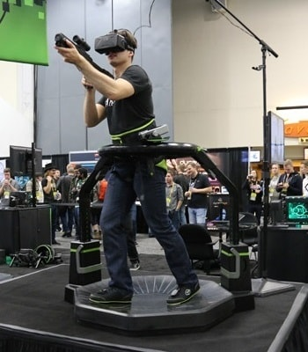
3. Fully-immersive simulations
Fully-immersive simulations provide the most immersive implementation of virtual reality technology. In a fully-immersive simulation, hardware such as head-mounted displays and motion detecting devices are used to stimulate all of a user's senses.
Fully immersive simulations are able to provide very realistic user experiences by delivering a wide field of view, high resolutions, increased update rates (also called refresh rate), and high levels of contrast into a user's head-mounted display (HMD).

Slide 38
Virtual Reality (VR) Equipment
VR headsets (VR glasses) include the following components:
Mobile phone or computer (for contents feed)
Displays
Lenses
Controls
Tracking sensors
Audio
Technical details: www.youtube.com/watch?v=BbY_GtaloaQ
What’s inside a VR headset: www.youtube.com/watch?v=8_X18EtYp8A

Slide 39
Key Components in a Virtual Reality System
1- PC (Personal Computer)/Console/Smartphone
Virtual reality content, which is the what users view inside of a virtual reality headset, is equally important as the headset itself. In order to power these interactive three-dimensional environments, significant computing power is required. This is where PC (Personal Computer), consoles, and smartphones come in. They act as the engine to power the content being produced. Head-Mounted Display
2-A head-mounted display (also called HMD, Headset, or Goggles) is a type of device that contains a display mounted in front of a user’s eyes. This display usually covers the user's full field of view and displays virtual reality content. Some virtual reality head mounted displays utilize smartphone displays, including the Google Cardboard or Samsung Gear VR. Head-mounted displays are often also accompanied with a headset to provide for audio stimulation.

Slide 40
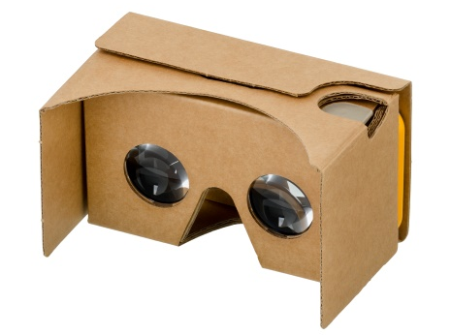
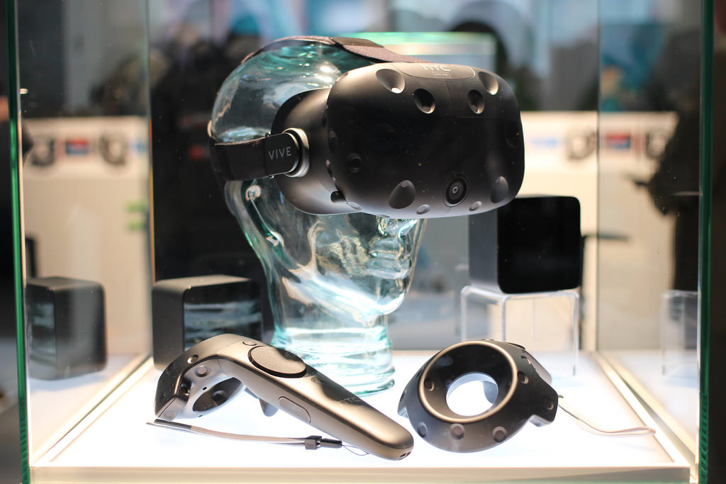
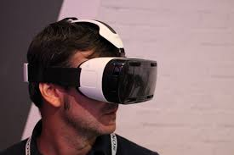
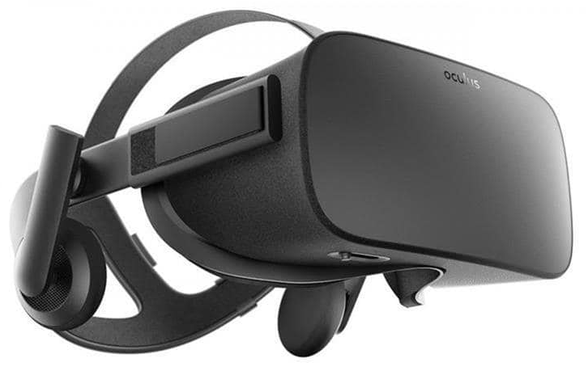
Virtual Reality (VR) Equipment
The most common VR equipment is the Headset (Head Mounted Display – HMD)
Source: Wikimedia Commons

Slide 41
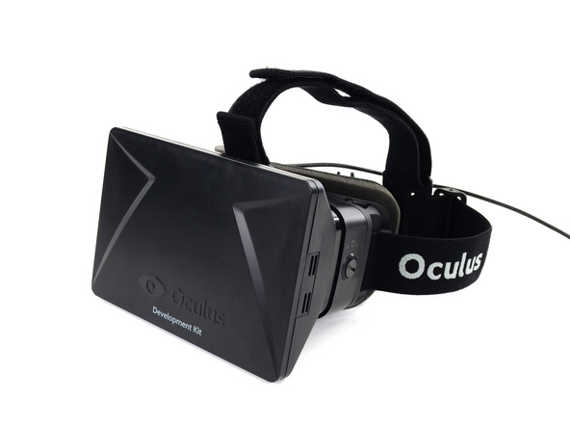
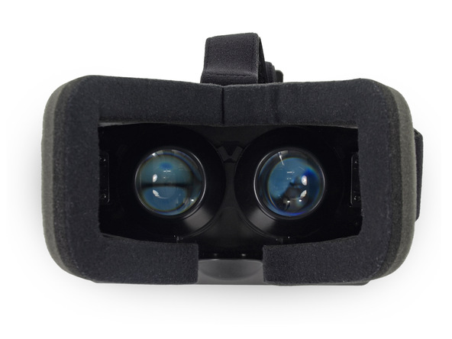
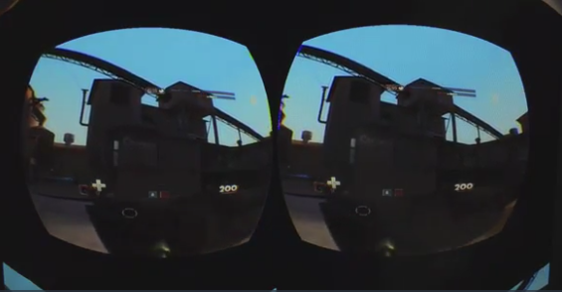
Headset example

Slide 42
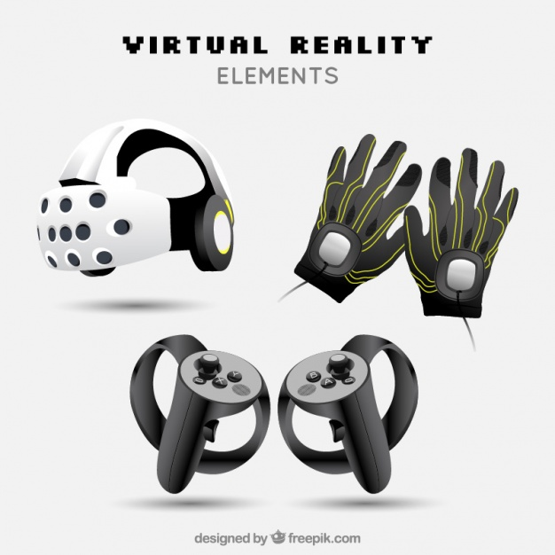
Other Virtual Reality (VR) Equipment
Other VR equipment can also be used for improving users’ experience and for improving interaction and control

Slide 43
Virtual Reality (VR) Software
Types
Applications allowing the creation of virtual environments (modeling software)
Applications for manipulating images and sounds
Specific software for supporting navigation, interaction, animation, simulation, collision detecting, audio etc.
Examples of free VR software
Unity 3D
Unreal Engine
Examples of freely available modelling software
Blender
Autodesk Fusion 360

Slide 44
Using Virtual Reality (VR) Software
The simplest way to experience VR Software is to make use of a readily developed app (such as games, 360 videos, etc.) and a pair of VR glasses.
- for more information about 360 videos:
https://en.wikipedia.org/wiki/360-degree_video
Example:
One can download and install a VR app from smartphone and use inexpensive cardboard VR glasses.
The user starts the application, places the phone within Cardboard glasses and mounts the VR glasses on the head.
Depending on app, this can be controlled using gaze or Cardboard lateral button.

Slide 45
Key Components in a Virtual Reality System (2)
3- Input devices are one of the two categories of components that provide users with a sense of immersion
They provide users with a more natural way to navigate and interact within a virtual reality environment.
Some of the more common forms of virtual reality input devices include:
Joysticks
Controller Wands
Data Gloves
On-Device Control Buttons
Motion Trackers/Bodysuits

Slide 46
Key Components Inside of a Virtual Reality Headset
Inside of each virtual reality head-mounted display (HMD) is a series of sensors, individual eye displays, lenses, and display screen(s), among other various components.
1- Sensors
The three most common sensors in a virtual reality headset are magnetometers, accelerometers and gyroscopes. These sensors work together by measuring the user’s motions and direction in space. Their ultimate goal is to achieve true six-degrees-of-freedom (6DoF), which covers all the degrees of motion for an object in space.
Magnetometer - The magnetometer tells your device which direction it is facing on the surface of the earth. The magnetometer acts as a sort of compass for the device. As such, it is able to do this by measuring magnetic fields.
Accelerometers - The accelerometer tells your device which way up it is. To do this, your device will have several accelerometers to work together measuring things like gravitational pull in relation the accelerometer measuring the device’s orientation.
Gyroscopes - A gyroscope calculates the orientation of your device. It does this to either help your device maintain a particular orientation or make sure it properly changes orientation when it should.

Slide 47
Key Components Inside of a Virtual Reality Headset (2)
2-Lenses
Lenses lie between your eyes and pixels on the display screen(s). They focus and reshape the picture for each eye by angling two 2D images to mimic how each of our eyes take in views of the world (also called stereoscopic). This creates an impression of depth and solidity, which we perceive to be a three-dimensional image.
3-Display Screens
Display screens show the images that user view through the lenses. They are typically LCD and receive video feed from the computer or smartphone. Depending on the headset, the video feed is either sent to one display or two displays (one per eye).

Slide 48
Key Components Inside of a Virtual Reality Headset (3)
4-Processing
Virtual reality systems demand a substantial amount of power, even in comparison to notoriously power hungry gaming systems. The processing power required by virtual reality systems can be broken down into several categories:
Input Processor – Controls the devices used to input information to the computer. They retrieve and distribute data to the rest of the system with minimal lag time. Examples include keyboards, mouses, 3D position trackers, and voice recognition systems.
Simulation Processor – Takes the user inputs along with any other tasks that are programmed from the natural world and determines the actions that will take place in the virtual world. This is a core component of the VR system.
Rendering Processor – Creates the sensations that are output to the user. These include visual, auditory, haptic and other sensory systems. Separate rendering processes are used for each sensory system.

Slide 49
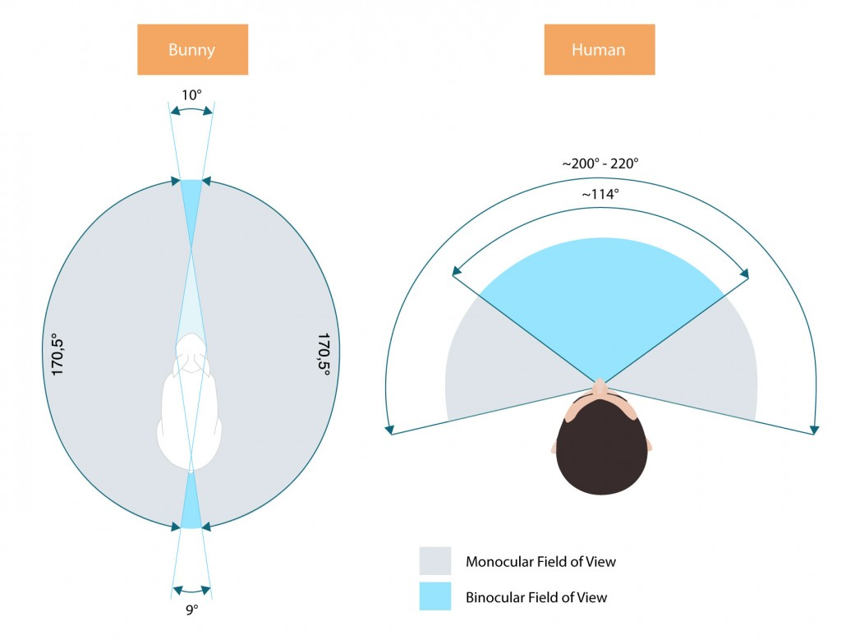
Concepts to Understand How Virtual Reality Headsets Work
1-Field of View
Field of view, or the extent of the observable environment at any given time, is one of the more important aspects of virtual reality. The wider the field of view, the more present the user is likely to feel in the experience. There are two types of FOV that work together to form human vision.
field of view refers to how wide the picture is. Field of view is measured based on the degree of display (e.g. 360°). Most high-end headsets make do with 100° or 110° field of view which is sufficient for most virtual reality content.

Slide 50
Concepts to Understand How Virtual Reality Headsets Work (2)
2-Frame Rate
Frame rate refers to the frequency (rate) at which the display screen shows consecutive images, which are also called frames.
Television shows run at 30 frames per second (fps) and some game consoles run at 60 frames per second (fps). In virtual reality, a minimum frame rate of approximately 60 frames per second is needed to avoid content stuttering or cause of simulation sickness.
The Oculus Rift runs at 90 fps, providing Oculus Rift users with a very lifelike experience. Future Frame rates for virtual reality headsets are set to inevitably continue getting faster, providing for a more realistic experience.

Slide 51
Concepts to Understand How Virtual Reality Headsets Work (3)
3- Latency
Latency refers to the amount of time it takes for an image displayed in a user’s headset to catch up to their changing head position. Latency can also the thought of as a delay, and is measured in milliseconds (ms). In order for an experience to feel real, latency usually needs to be in the range of 20 milliseconds (ms) or less.
Low latency, or very little delay, is needed to make the human brain accept the virtual environment as real.
The lower the latency, the better.
The higher the latency, a noticeable and unnatural lag may set in, consequently causing simulation sickness for the user.
4- Audio
Virtual reality audio may not be as technically-complex as the visual components, however, it is an equally important component to stimulate a user’s senses and achieve immersion.

Slide 52
Concepts to Understand How Virtual Reality Headsets Work (4)
5- Tracking
Tracking handles the vital task of understanding a user’s movements and then acting upon them accordingly to maintain full immersion in virtual reality. Below, we explore the three of the main types of virtual reality tracking:
Head Tracking
Motion Tracking
Eye Tracking

Slide 53
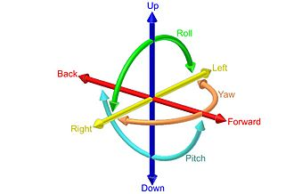
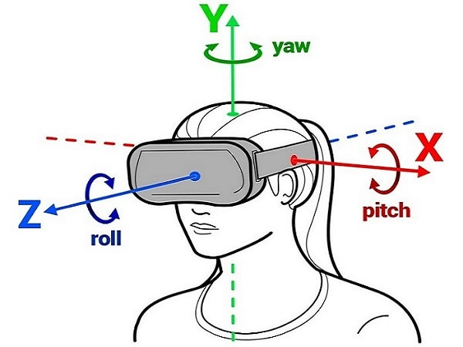
A - Head Tracking
Head tracking refers to the way in which the view in front of you will shift as you look up, down and side-to-side.
Six degrees of freedom (6DoF) refers to the freedom of movement of a rigid body in three-dimensional space. Specifically, the body is free to change position as forward/backward (surge), up/down (heave), left/right (sway) translation in three perpendicular axes, combined with changes in orientation through rotation about three perpendicular axes, often termed yaw (normal axis), pitch (lateral axis), and roll (longitudinal axis).
Head tracking utilizes a series of sensors which includes:
a gyroscope, accelerometer, and magnetometer.
Head-tracking technology must be low latency in order to be effective. Anything above 50ms will cause a lag between the headset movement and virtual reality environment changes.

Slide 54
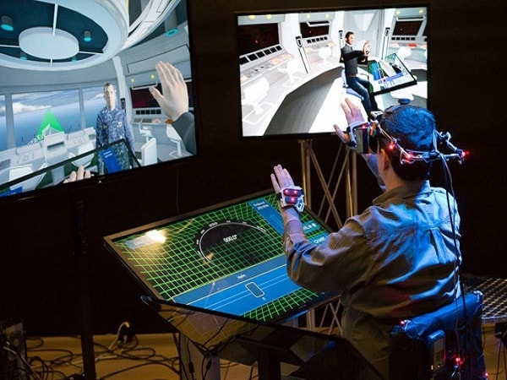
B- Motion Tracking
Motion tracking is the way in which you view and interact with your own body (e.g. hands, movements, etc). One of the most natural motion-related acts is to want to be able to see your own hands (virtually) in front of you. To do this, virtual reality input accessories such as gloves can be used. Other motion tracking devices such as wireless controllers, joysticks, treadmills, and motion platforms are now being used to supplement the headset and provide an even more immersive experience. Many of these input accessories utilize sensors to detect gestures such as pointing and waving. Virtual reality systems such as HTC’s Vive headset, utilize base stations to track the sensors from the headset and controllers.

Slide 55
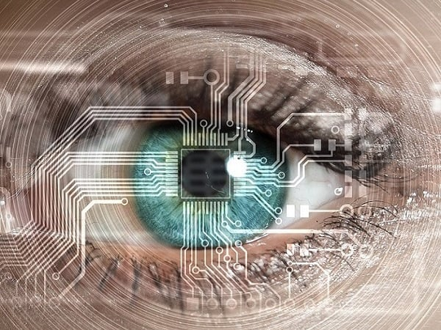
C- Eye Tracking
Eye tracking technology is still maturing, however, it may be one of the most important missing pieces to complete the virtual reality full immersion puzzle. Eye tracking involves tracking the human eyes via an infrared sensor that monitors your eye movement inside the headset. The main advantage to this type of tracking is that depth of field (i.e. distance) becomes much more realistic. In a virtual reality headset, the objects that our eyes focus on, need to look as life-like as possible. Without eye tracking, everything remains in focus as you move your eyes - but not your head - around a scene, thus causing a greater likeliness of simulation sickness.

Slide 56
Web XR
An deprecated standard named WebVR has been replaced by WebXR
WebXR is a group of standards which are used together to support rendering 3D scenes to hardware designed for presenting virtual worlds (virtual reality, or VR), or for adding graphical imagery to the real world, (augmented reality, or AR).
The WebXR Device API implements the core of the WebXR feature set, managing the selection of output devices, render the 3D scene to the chosen device at the appropriate frame rate, and manage motion vectors created using input controllers.
WebXR-compatible devices include fully-immersive 3D headsets with motion and orientation tracking, eyeglasses which overlay graphics atop the real world scene passing through the frames, and handheld mobile phones which augment reality by capturing the world with a camera and augment that scene with computer-generated imagery.
https://developer.mozilla.org/en-US/docs/Web/API/WebXR_Device_API

Slide 57
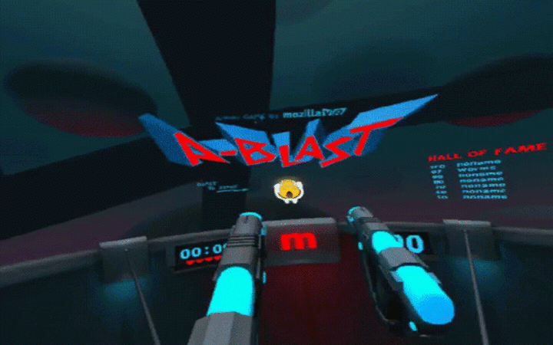
Aframe
A-Frame is a web framework for building virtual reality (VR) experiences.
A-Frame is based on top of HTML, making it simple to get started. But A-Frame is not just a 3D scene graph or a markup language; the core is a powerful entity-component framework that provides a declarative, extensible, and composable structure to three.js.
A-Frame was developed to be an easy yet powerful way to develop VR content. As an independent open source project, A-Frame has grown to be one of the largest VR communities.
A-Frame supports most VR headsets such as Vive, Rift, Windows Mixed Reality, Daydream, GearVR, Cardboard, Oculus Go, and can even be used for augmented reality. Although A-Frame supports the whole spectrum, A-Frame aims to define fully immersive interactive VR experiences that go beyond basic 360° content, making full use of positional tracking and controllers.
https://aframe.io/docs/1.1.0/introduction

Slide 58
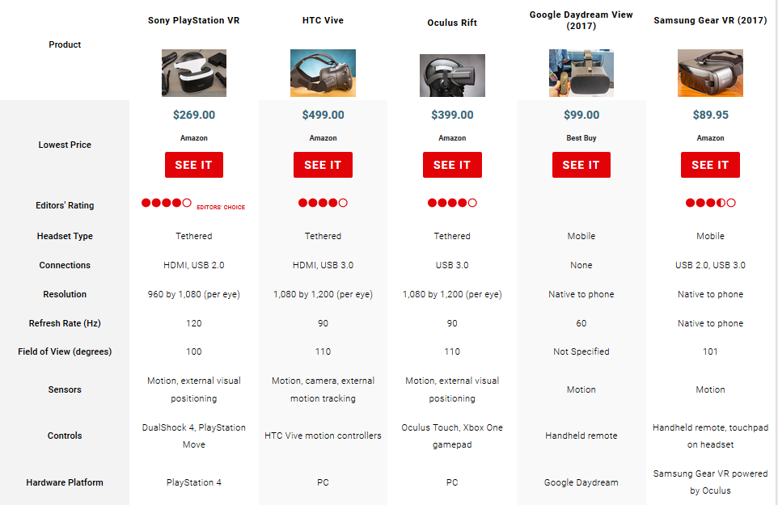
Comparison of VR headsets للاطلاع https://www.pcmag.com/article/342537/the-best-virtual-reality-vr-headsets

Slide 59
VR sdk Comparison (1) للاطلاع https://thinkmobiles.com/blog/best-vr-sdk/
Product | HTC Vive | Sony PlayStation VR | Oculus Rift | Samsung Gear VR | Google Daydream View | Google Cardboard
Headset type | PC | Console | PC | Mobile | Mobile | Mobile
Connections | HDMI, USB 3.0 | HDMI, USB 2.0 | USB 3.0 | USB 2.0, USB 3.0 | None | None
Resolution (per eye) | 1080×1200 | 960×1080 | 1080×1200 | Native to phone | Native to phone | Native to phone
Field of view | 110° | 100° | 110° | 101° | 100° | 90°
Refresh rate (Hz) | 90 | 120 | 90 | Native to phone | Native to phone | Native to phone
Sensors | Motion, camera, external motion tracking | Motion, external visual positioning | Motion, external visual positioning | Motion | Motion | Motion
Controls | HTC Vive motion controllers | DualShock 4, PlayStation Move | Oculus Touch, Xbox One gamepad | Handheld remote, touchpad on headset | Handheld remote | Handheld remote

Slide 60
VR sdk Comparison (2) للاطلاع https://thinkmobiles.com/blog/best-vr-sdk/
Product | HTC Vive | Sony PlayStation VR | Oculus Rift | Samsung Gear VR | Google Daydream View | Google Cardboard
Software platform | SteamVR | PlayStation 4 | Oculus | Android | Android 7.0 Nougat | Android, iOS
Engines:
Unity | + | + | + | + | + | +
Unreal Engine | + | + | + | + | + | +
OpenVR | +
AppGameKit VR | + |  | +
CryEngine | + | + | +
CopperCube |  |  | +
Positional tracking | + | + | +
Head tracking | Accelerometer, gyroscope, structured light | Accelerometer, gyroscope | Accelerometer, gyroscope, magnetometer | Accelerometer, gyrometer, proximity sensor | Accelerometer, gyrometer, proximity | Accelerometer, gyrometer
Price (Amazon) | $599.00 | $374.95 | $399.00 | $112.89 | $71.99

Slide 61
references
https://www.newgenapps.com/blog/augmented-reality-technology-how-ar-works
http://www.realitytechnologies.com/virtual-reality

